Slide 1
Myers-Briggs Personality Prediction Using Machine Learning Techniques
Submitted by:
Atul Chandra
Jan 2025 Batch
Notes:
Personality typing is a way of categorizing people according to their tendencies to think and act in particular ways. The most popular system of personality typing was developed by Isabel Briggs Myers and her mother, Katharine Briggs, in the 1960's. Myers and Briggs proposed using four key dichotomies to differentiate people: Introversion vs. Extraversion, Sensing vs. Intuition, Thinking vs. Feeling, and Judging vs. Perceiving.

Slide 2
Myers-Briggs Personalities type
ENFJ
INFJ
INTJ
ENTJ
Teacher
Counselor
Mastermind
Field Marshall
2.5%
1.5%
2.1%
1.8%
Barack Obama
Martin Luther Jr.
Nelson Mandela
Mahatma Gandhi
Carl Jung
APJ Adbul Kalam
Elon Musk
Christopher Nolan
Michelle Obama
Ratan Tata
Steve Jobs
Bill Gates
Key dichotomies
ENFP
INFP
INTP
ENTP
ENERGY STYLE
COGNITIVE STYLE
VALUES STYLE
LIFE
STYLE
Champion
Healer
Architect
Inventor
8.1%
4.4%
3.3%
3.2%
Extraverts
Sensors
Thinkers
Judgers
Mark Twain
Dr. Suess
John Lennon
William Shakespeare
JRR Tolkien
Vincent van Gogh
Albert Einstein
Charles Darwin
JRD Tata
Leonardo da Vinci
Nikola Tesla
Thomas Edison
E
S
T
J
ESFP
ISFP
ISTP
ESTP
Performer
Composer
Operator
Promoter
8.5%
8.8%
5.4%
4.3%
I
N
F
P
Aamir Khan
Elvis Presley
Leonardo DiCaprio
Lata Mangeshkar
Michael Jackson
Mozart
Bruce Lee
Bear Grylls
Tom Cruise
Winston Churchill
Donald Trump
Dwayne Johnson
Introverts
Intuitives
Feelers
Perceivers
ESFJ
ISFJ
ISTJ
ESTJ
Provider
Protector
Inspector
Supervisor
12.3%
13.8%
11.6%
8.7%
Bill Clinton
Hugh Jackman
Pope Francis
Rosa Parks
Queen Elizabeth II
Mother Teresa
Warren Buffett
Jeff Bezos
Angela Merkel
Steve Ballmer
Henry Ford
George Washington
Notes:
MBTI test have ~93 questions to classify 16 personalities.
ENJF(Teacher) - ENFJs are idealist organizers, driven to lead others toward their insightful vision of what is best for humanity.
INFJ(Counselor) - INFJs are creative nurturers with a strong sense of personal integrity and a drive to help others realize their potential.
INTJ(Mastermind) - INTJs are analytical problem-solvers, eager to improve systems and processes with their innovative ideas.
ENTJ(Commander) – ENTJs are strategic leaders, motivated to take charge, develop efficient solutions, and implement impactful change.
ENFP(Champion) - ENFPs are people-centered creators with a focus on possibilities and a contagious enthusiasm for new ideas, people and activities.
INFP(Healer) - INFPs are imaginative idealists, guided by their own unique core values and beliefs.
INTP(Architect) – INTPs are philosophical innovators, fascinated by logical analysis, systems, and design.
ENTP(Visionary) – ENTPs are inspired innovators, motivated to find new solutions to intellectually challenging problems.
ESFP( Performer) – ESFPs are vivacious entertainers who charm and engage those around them with their fun-loving spontaneity.
ISFP(Composer) – ISFPs are gentle caretakers who live in the present moment and enjoy their surroundings with cheerful, low-key enthusiasm.
ISTP(Craftsperson) – ISTPs are observant artisans with an understanding of mechanics and an interest in troubleshooting.
ESTP(Dynamo) – ESTPs are energetic thrill seekers who bring a sense of dynamic energy to their interactions with others and the world around them.
ESFJ(Provider) – ESFJs are conscientious helpers, sensitive to the needs of others and energetically dedicated to their responsibilities.
ISFJ(Protector) – ISFJs are industrious caretakers, loyal to institutions and ready to do the hard work to take care of the people around them.
ISTJ(Inspector) – ISTJs are responsible organizers, driven to create and enforce order within systems and institutions.
ESTJ(Supervisor) - ESTJs are hardworking traditionalists, eager to take charge in organizing projects and people.
Layer 1 – 7.9%
Layer 2 – 19%
Layer 3 – 27%
Layer 4 – 46.4%
Layer3/4 – 73.4%
Introverts – 50.9%
Extroverts – 49.1%

Slide 3
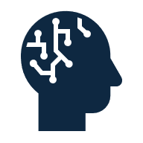





Objective Predict the personality type using a ML model
Enhance self-awareness
Improve interpersonal skills
Increase team effectiveness
Strengths and weaknesses
Understanding preferences and behaviors
Teams work better together
Strengthen communication
Support skill and career development
Reduce conflict
Others' preferred communication styles
Explore career paths and roles
Understanding personality preferences can reduce misunderstandings
Notes:
Enhance self-awareness: It helps individuals understand their own strengths, weaknesses, likes, and dislikes.
Improve interpersonal understanding: It provides a framework for understanding why people may differ in their preferences and behaviors, which can lead to better communication and relationships.
Increase team effectiveness: Organizations use it to help teams work better together by providing a common language to discuss and appreciate personality differences.
Strengthen communication: It can help individuals identify their own and others' preferred communication styles, enabling them to adapt and communicate more effectively.
Support skill and career development: By understanding personality preferences, individuals can explore career paths and roles that may be a better fit for them.
Reduce conflict: Understanding differences in personality preferences can help reduce misunderstandings that lead to conflict.

Slide 4
Approach
Data Preparation
Exploratory Data Analysis
Model Training
Data preparation
- Input Features
Age Gender Education
Introversion score Sensing Score Thinking Score
Judging Score Interest Personality
- Graph Analysis
- Features Distribution
- Features Correlation
- Classification problem
- Standardization
- Split data
- Model selection
EDA
- Handling missing data
- Handling duplicate data
- Label encoding
Select and train model
Model Performance
Parameter Tuning
Best Model
Model's performance
GridSearchCV
- max depth
- n_estimator
Out of all the models trained Random Forest Classifier With 89.5% accuracy.
- Cross Validation
- Accuracy
- Confusion Matrix
- Precision
- Recall
- F1 Score
Parameter Tuning
Notes:
Enhance self-awareness: It helps individuals understand their own strengths, weaknesses, likes, and dislikes.
Improve interpersonal understanding: It provides a framework for understanding why people may differ in their preferences and behaviors, which can lead to better communication and relationships.
Increase team effectiveness: Organizations use it to help teams work better together by providing a common language to discuss and appreciate personality differences.
Strengthen communication: It can help individuals identify their own and others' preferred communication styles, enabling them to adapt and communicate more effectively.
Support skill and career development: By understanding personality preferences, individuals can explore career paths and roles that may be a better fit for them.
Reduce conflict: Understanding differences in personality preferences can help reduce misunderstandings that lead to conflict.

Slide 5
Model Summary
Data
Data Processing
Description | Values
Records | 34500
Missing Values | 0
Duplicate Values | 704
Train Data | 27037
Test Data | 7463
Data Cleaning
-Remove duplicate values
-Standardization of data
Data split
- 80% Training data
- 20% Test data
EDA
Machine Learning Models & Metric
Data distribution
- Personality
- Age
- Gender
- Personality vs Introversion score
- Personality vs Sensing score
- Personality vs Judging score
- Personality vs Thinking score
Feature Correlation heatmap
Softmax classification
Random forest classification
SVM classification
Notes:
Enhance self-awareness: It helps individuals understand their own strengths, weaknesses, likes, and dislikes.
Improve interpersonal understanding: It provides a framework for understanding why people may differ in their preferences and behaviors, which can lead to better communication and relationships.
Increase team effectiveness: Organizations use it to help teams work better together by providing a common language to discuss and appreciate personality differences.
Strengthen communication: It can help individuals identify their own and others' preferred communication styles, enabling them to adapt and communicate more effectively.
Support skill and career development: By understanding personality preferences, individuals can explore career paths and roles that may be a better fit for them.
Reduce conflict: Understanding differences in personality preferences can help reduce misunderstandings that lead to conflict.

Slide 6
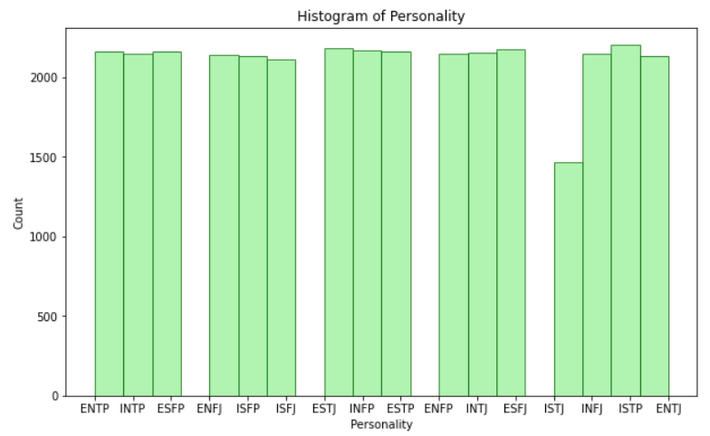
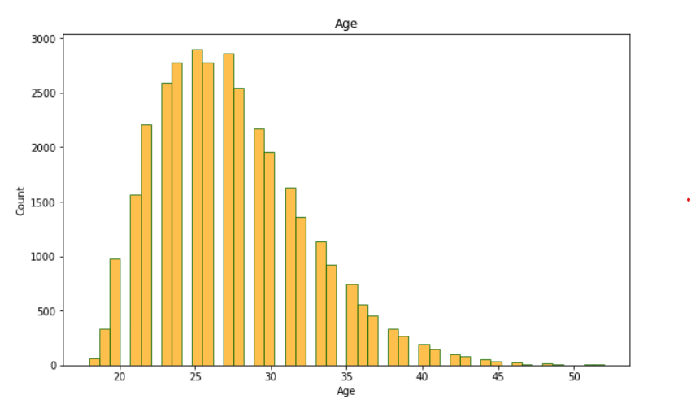
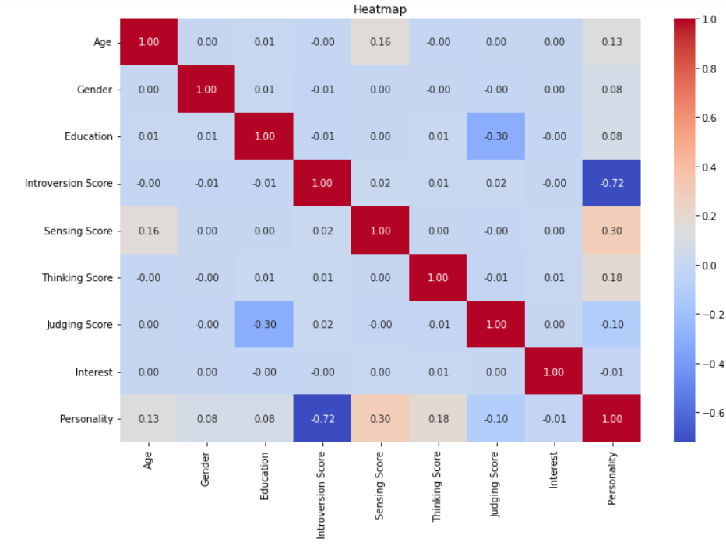
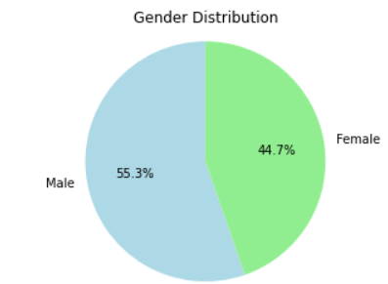
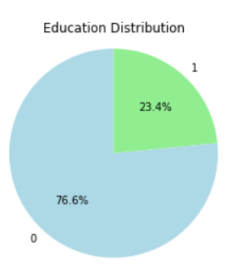
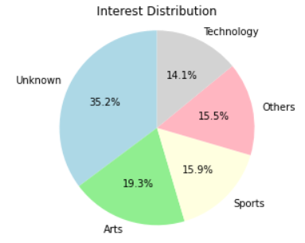
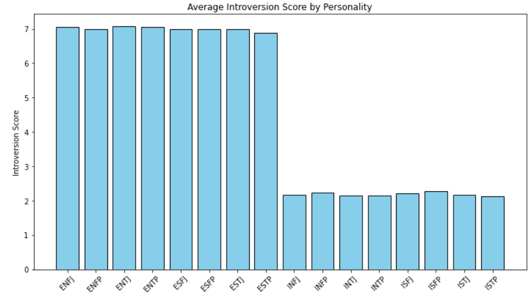
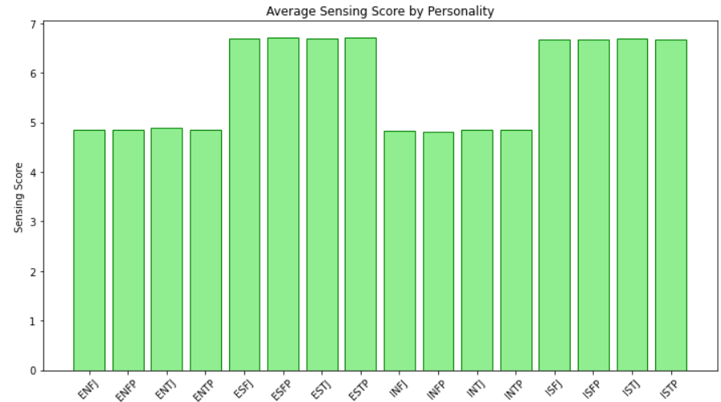
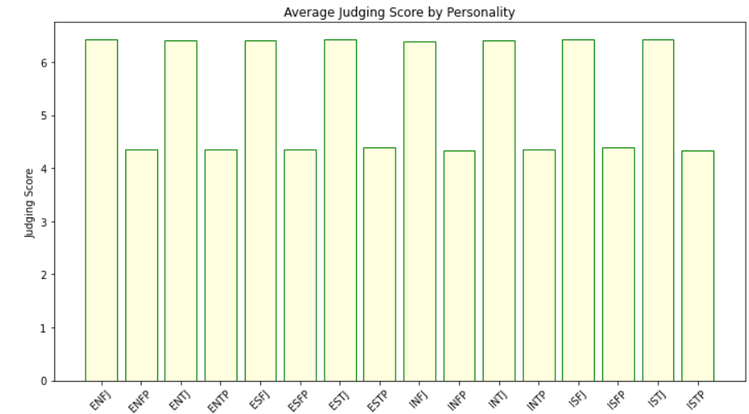
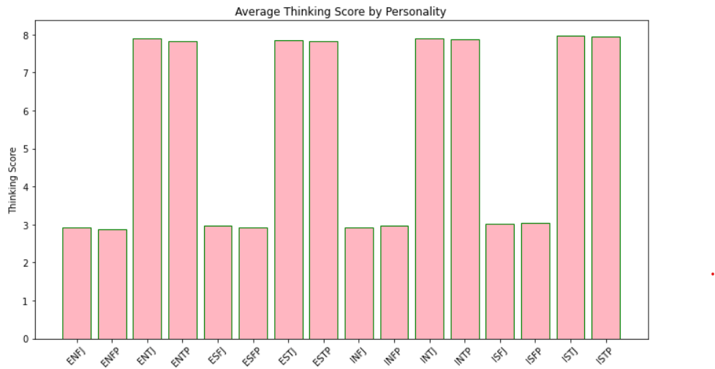
Model Summary
Data Distribution
Feature correlation
Data Distribution
Machine Learning Models & Metric
Model | Accuracy
Softmax Classification | 78%
SVM Classifier | 82%
Random Forrest classification | 89%
Voting Classifier | 84%
Notes:
Enhance self-awareness: It helps individuals understand their own strengths, weaknesses, likes, and dislikes.
Improve interpersonal understanding: It provides a framework for understanding why people may differ in their preferences and behaviors, which can lead to better communication and relationships.
Increase team effectiveness: Organizations use it to help teams work better together by providing a common language to discuss and appreciate personality differences.
Strengthen communication: It can help individuals identify their own and others' preferred communication styles, enabling them to adapt and communicate more effectively.
Support skill and career development: By understanding personality preferences, individuals can explore career paths and roles that may be a better fit for them.
Reduce conflict: Understanding differences in personality preferences can help reduce misunderstandings that lead to conflict.

Slide 7
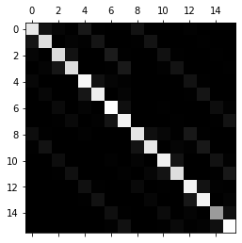

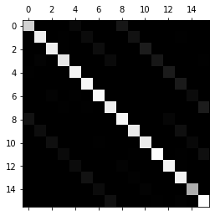
Result
Softmax Classifier
SVM Classifier
RandomForest Classifier
Personality type | Precision | recall | f1-score
0 | 0.78 | 0.75 | 0.76
1 | 0.85 | 0.75 | 0.8
2 | 0.81 | 0.73 | 0.77
3 | 0.82 | 0.74 | 0.78
4 | 0.77 | 0.81 | 0.79
5 | 0.79 | 0.78 | 0.79
6 | 0.77 | 0.83 | 0.8
7 | 0.77 | 0.78 | 0.78
8 | 0.78 | 0.76 | 0.77
9 | 0.83 | 0.77 | 0.8
10 | 0.74 | 0.77 | 0.75
11 | 0.8 | 0.78 | 0.79
12 | 0.74 | 0.82 | 0.78
13 | 0.72 | 0.79 | 0.75
14 | 0.75 | 0.77 | 0.76
15 | 0.76 | 0.82 | 0.79
accuracy |  |  | 0.78
macro avg | 0.78 | 0.78 | 0.78
weighted avg | 0.78 | 0.78 | 0.78
Personality type | Precision | recall | f1-score
0 | 0.83 | 0.82 | 0.82
1 | 0.9 | 0.74 | 0.81
2 | 0.83 | 0.8 | 0.81
3 | 0.86 | 0.75 | 0.8
4 | 0.81 | 0.86 | 0.84
5 | 0.85 | 0.81 | 0.83
6 | 0.81 | 0.9 | 0.86
7 | 0.82 | 0.83 | 0.82
8 | 0.85 | 0.84 | 0.85
9 | 0.87 | 0.75 | 0.8
10 | 0.79 | 0.85 | 0.82
11 | 0.86 | 0.81 | 0.83
12 | 0.75 | 0.9 | 0.82
13 | 0.78 | 0.79 | 0.79
14 | 0.76 | 0.85 | 0.8
15 | 0.8 | 0.85 | 0.82
accuracy |  |  | 0.82
macro avg | 0.82 | 0.82 | 0.82
weighted avg | 0.83 | 0.82 | 0.82
Personality type | Precision | recall | f1-score
0 | 0.91 | 0.87 | 0.89
1 | 0.93 | 0.88 | 0.9
2 | 0.92 | 0.85 | 0.88
3 | 0.94 | 0.85 | 0.9
4 | 0.92 | 0.89 | 0.91
5 | 0.88 | 0.9 | 0.89
6 | 0.91 | 0.93 | 0.92
7 | 0.9 | 0.89 | 0.89
8 | 0.9 | 0.91 | 0.91
9 | 0.91 | 0.89 | 0.9
10 | 0.88 | 0.9 | 0.89
11 | 0.91 | 0.9 | 0.9
12 | 0.88 | 0.94 | 0.91
13 | 0.83 | 0.92 | 0.87
14 | 0.89 | 0.91 | 0.9
15 | 0.85 | 0.93 | 0.89
accuracy |  |  | 0.9
macro avg | 0.9 | 0.9 | 0.9
weighted avg | 0.9 | 0.9 | 0.9
Precision vs Recall
vs F1 score
Confusion matrix
Notes:
Enhance self-awareness: It helps individuals understand their own strengths, weaknesses, likes, and dislikes.
Improve interpersonal understanding: It provides a framework for understanding why people may differ in their preferences and behaviors, which can lead to better communication and relationships.
Increase team effectiveness: Organizations use it to help teams work better together by providing a common language to discuss and appreciate personality differences.
Strengthen communication: It can help individuals identify their own and others' preferred communication styles, enabling them to adapt and communicate more effectively.
Support skill and career development: By understanding personality preferences, individuals can explore career paths and roles that may be a better fit for them.
Reduce conflict: Understanding differences in personality preferences can help reduce misunderstandings that lead to conflict.

Slide 8
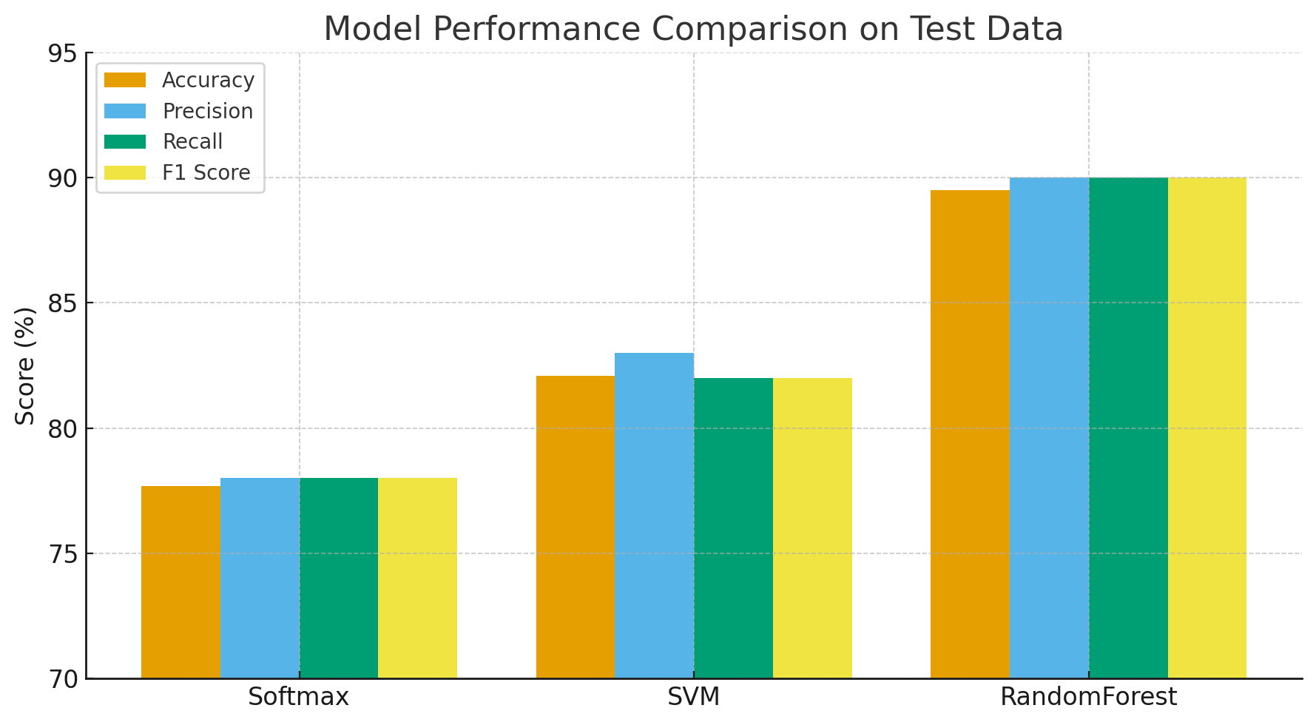
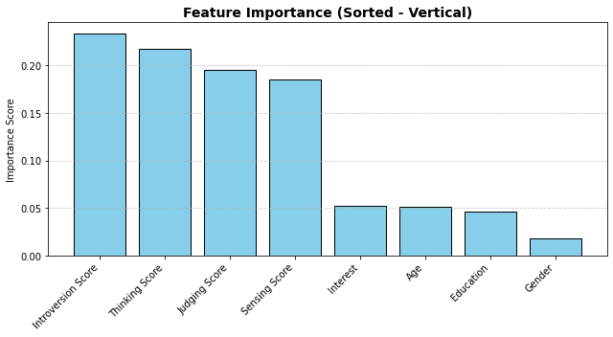
Inference
The model performance comparison shows that the Random Forest classifier achieved the highest overall results, with 89.5% accuracy, 90% precision, 90% recall, and an F1 score of 90%, indicating strong and balanced predictive performance. The SVM model performed moderately well with 82.1% accuracy, while the Softmax model showed comparatively lower accuracy at 77.7%.
The feature importance analysis from the Random Forest model highlights that Introversion Score (23.4%), Thinking Score (21.8%), and Judging Score (19.6%) are the most influential factors contributing to the predictions. Sensing Score (18.6%) also plays a significant role, while demographic variables such as Age, Education, and Interest have comparatively smaller impacts.

Slide 9
Reference
MBTI personalities description
https://en.wikipedia.org/wiki/Myers%E2%80%93Briggs_Type_Indicator
MBTI personalities Stats
https://thequestinpodcast.com/mbti-statistics/
Data source
https://www.kaggle.com/datasets/stealthtechnologies/predict-people-personality-types
Github repository
https://github.com/a-t-ul/Capstone-project-2025

Slide 10

Questions and Thank you!
Presented by
Atul Chandra
chandra.atul@gmail.com

